Slide 1
Dynamic Network Topology Portrait for Digital Twin Optical Network
A multifactor-associated network topology portrait (NTP) scheme is proposed to draw a dynamic, real-time, and comprehensive topology representation for the DT optical network (DTON).
Multiple parameters from nodes and links are jointly evaluated, including link distance, link loss, optical signal-to-noise ratio, bandwidth utilization rate, load capacity, node failure rate, and link failure rate, involving both the network layer and physical layer.
The performance of dynamic routing computation, for six different routing algorithms, is studied based on the NTP. Improvements in outage probability, outage latency, and the number of service requests can be seen at the cost of time for routing computation.

Slide 2
Dynamic Network Topology Portrait for Digital Twin Optical Network
DTON is envisioned to pave the way for close monitoring, high-fidelity modeling, real-time interaction, and dynamic network orchestration for autonomous optical networks.
One of DTON's primary tasks at the network layer is to create a mirror model of network topology (NT) to describe the comprehensive network structure and status information. This is crucial for dynamic routing computation, flexible resource allocation, and accurate traffic prediction.
Establishing the mirror model for network topology requires a comprehensive scheme to describe the physical structure and logical relationships, including network status and system condition information.

Slide 3
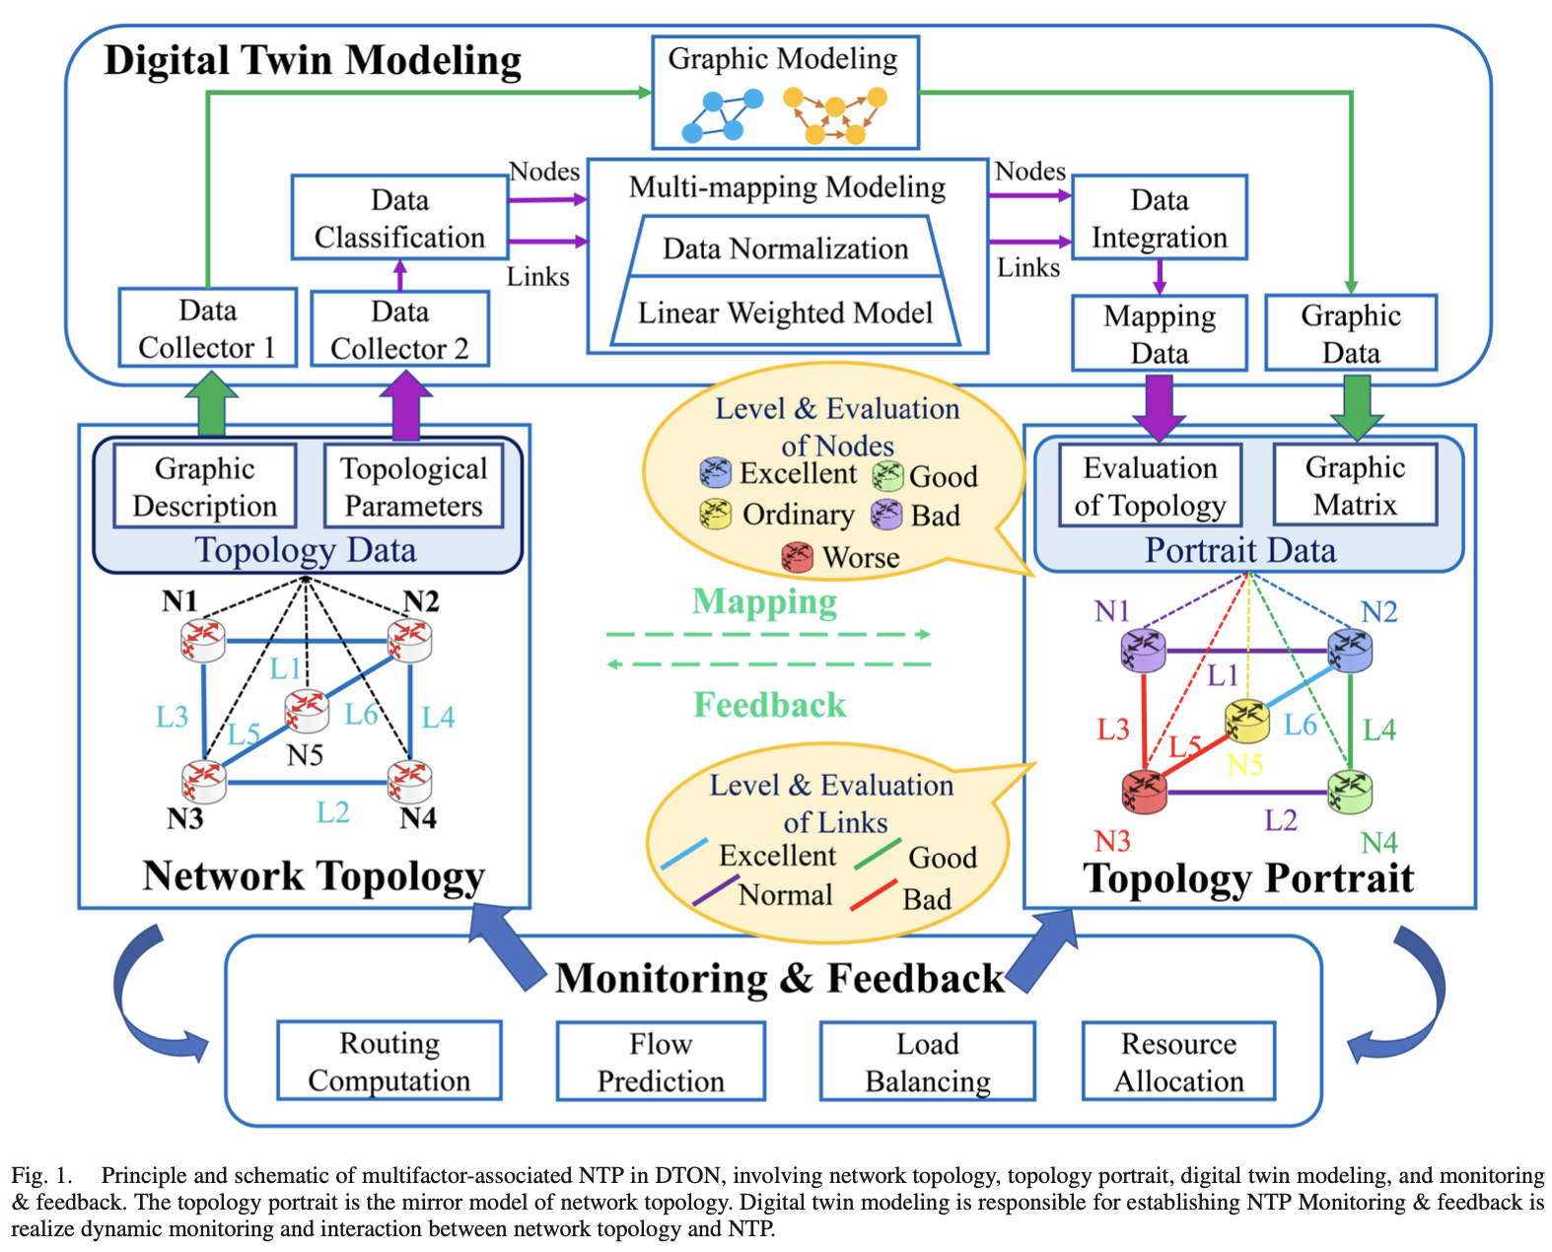
Dynamic Network Topology Portrait for Digital Twin Optical Network
Principles of NTP -

Slide 4
Dynamic Network Topology Portrait for Digital Twin Optical Network
Principles of NTP - the NTP is composed of four key parts: network topology, topology portrait, DT modeling, and monitoring & feedback system.
Network topology comprises the graphic description and topological parameters.
For nodes, five parameters are considered, involving geographic location, load capacity, traffic rating, node failure rate, and connectivity.
For links, five more parameters are considered, including the link distance, transmission loss, OSNR, link failure rate, and bandwidth utilization rate.
DT modeling, the graphic data, and performance parameters of the network topology are converted into the graphic matrix and comprehensive evaluation under multiple factors through graphic modeling and multi-mapping modeling.
All the evaluations above are integrated into a comprehensive evaluation of nodes and links after data normalization and linear weighting.
According to the evaluation scores, all the nodes are ranked into five levels (excellent, good, ordinary, bad, and worse) and links are ranked into four levels (excellent, good, normal, and bad)

Slide 5
Dynamic Network Topology Portrait for Digital Twin Optical Network
Principles of NTP –
Topology portrait is presented intuitively and vividly by integrating the multifactor-associated evaluation into the graphic matrix.
With the aid of the topology portrait in DTON, the solutions for the accident of network topology as well as adjustments can be provided for different tasks, such as routing computation, traffic prediction, load balancing, or resource allocation.
In dynamic scenarios, the monitoring & feedback system enables the topology portrait to be adjusted in real-time based on monitoring of the change of parameters from the network topology.
The optimization strategy and control action are fed back to the network system

Slide 6
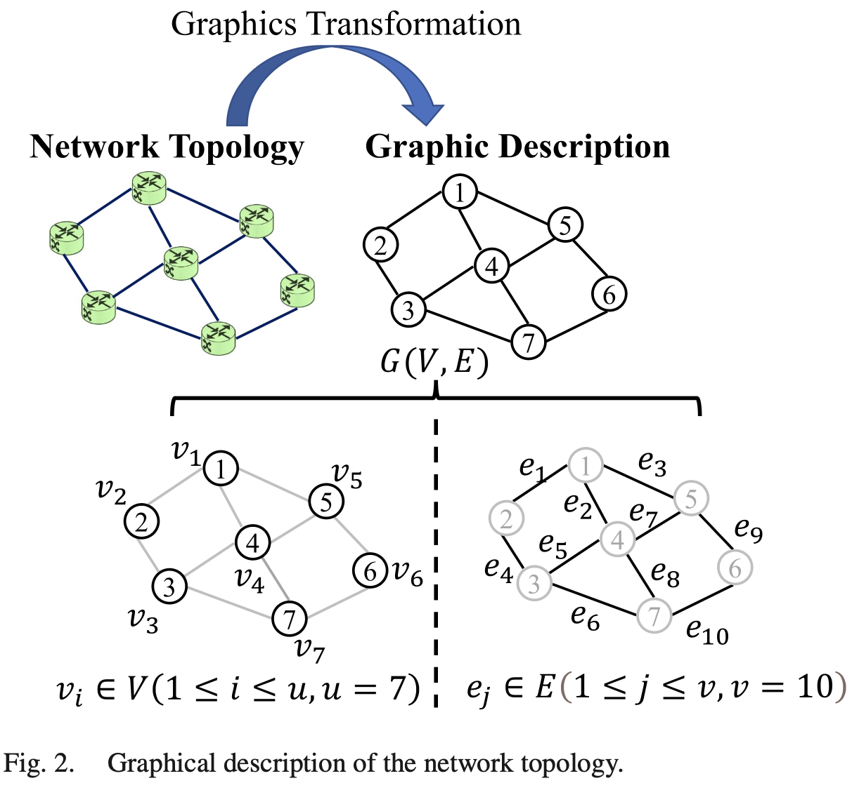
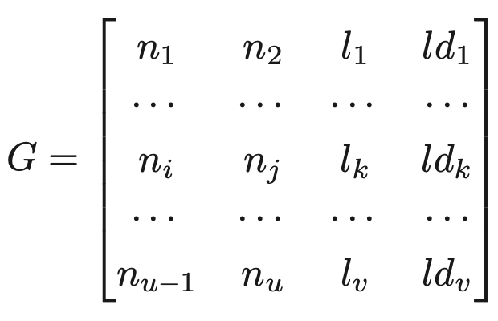
Dynamic Network Topology Portrait for Digital Twin Optical Network
Graphic Modeling of NTP –
Network topology - an undirected graph G(V, E).
the graphic matrix is defined as G
Where the serial number of each node and link corresponds to n_{i} (i ∈ [1,u]) and l_{k} (k ∈ [1,v]). The measured distance of each link is defined as ld_{k} (k ∈ [1,v])

Slide 7
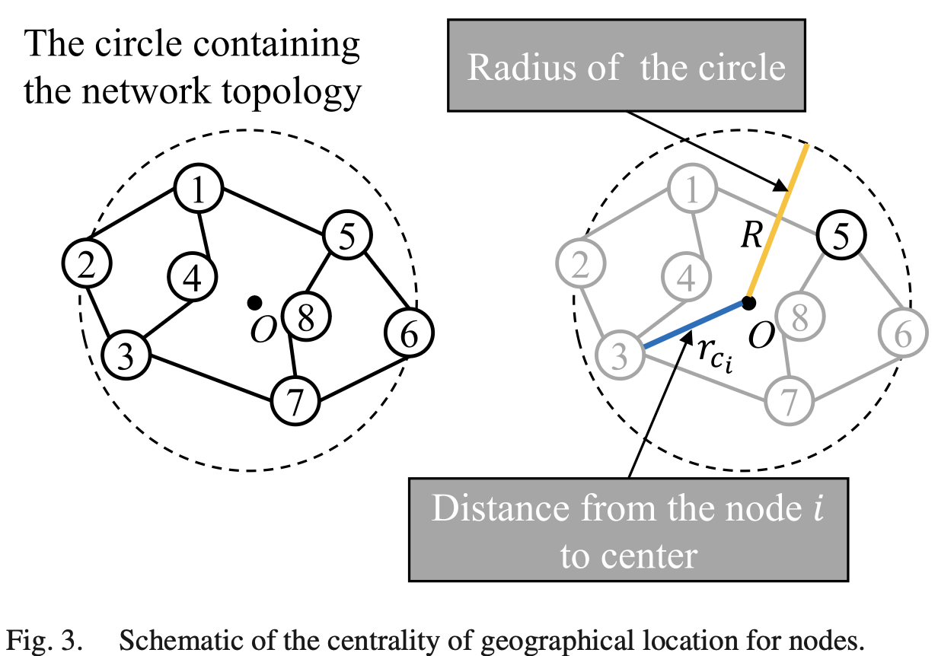
Dynamic Network Topology Portrait for Digital Twin Optical Network
Parametric Model for NTP –
The purpose of the parametric model is to provide a richer and more comprehensive description of NTP in DTON
Geographical Location - the definition of the distance from the point to the center of the circle is introduced, aiming to enrich the NTP in terms of nodes with the geographical characteristics for DTON
wherein radius R is half of the distance between the two
farthest nodes in the topology
Based on the centrality of the geographical location of
nodes, the connectivity of nodes is considered as
another aspect of the geographic feature of nodes.

Slide 8
Dynamic Network Topology Portrait for Digital Twin Optical Network
Parametric Model for NTP –
Traffic Rating –
Increasing single-wavelength rates boosts service transmission capacity in optical networks and significantly improves traffic ratings.
Node traffic ratings are categorized into four levels, aligning with single-wavelength rates of 800 Gbit/s, 400 Gbit/s, 200 Gbit/s, and 100 Gbit/s, and corresponding traffic rates are 1,2,3,4 respectively.
Load Capacity –
The load status of nodes indicates the maximum volume of service requests of nodes.
For the links, the parameters are also divided into five parts, involving the link distance, transmission loss, OSNR, link failure rate, and bandwidth utilization rate.

Slide 9
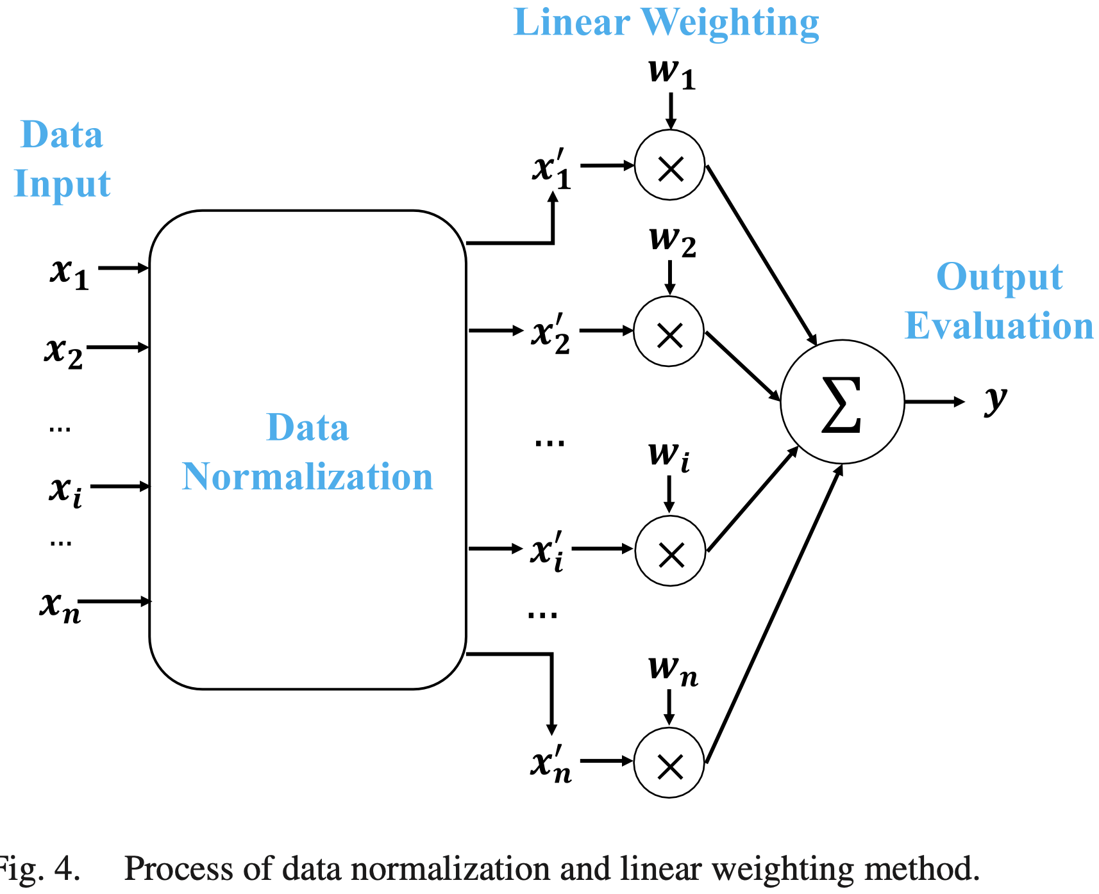
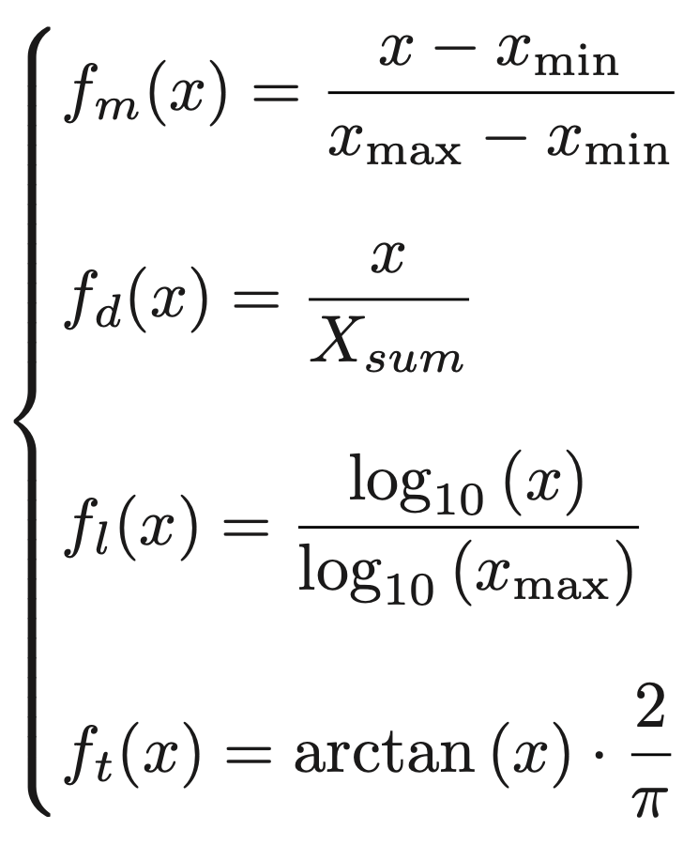
Dynamic Network Topology Portrait for Digital Twin Optical Network
Data Normalization and Comprehensive Evaluation for Multi-Parameter Nodes and Links –
Min-Max standardization, ratio normalization, log normalization, and trigonometric normalization

Slide 10
Dynamic Network Topology Portrait for Digital Twin Optical Network
Simulation –
Compared with the ratio method, the data set's span under Min-Max standardization remains valid. Meanwhile, Min-Max standardization has no disadvantages mentioned in log normalization and trigonometric normalization. Therefore Min-Max standardization is finally selected for describing NTP in the following parts.
The mean discriminability values for nodes and links respectively are:
for NTP with NSFNET: 83.55% and 75.55
For NTP with CERNET: 70.56% and 62.55%
For NTP with 98 nodes: 60.56% and 50.14%
Algorithms used - Dijkstra algorithm, Bellman-Ford algorithm, the shortest path faster algorithm (SPFA) (traditional routing algorithms), k shortest paths algorithm (KSP) based on Yen’s, A-star (A*) algorithm, and branch and bound method(improved routing algorithms).

Slide 11
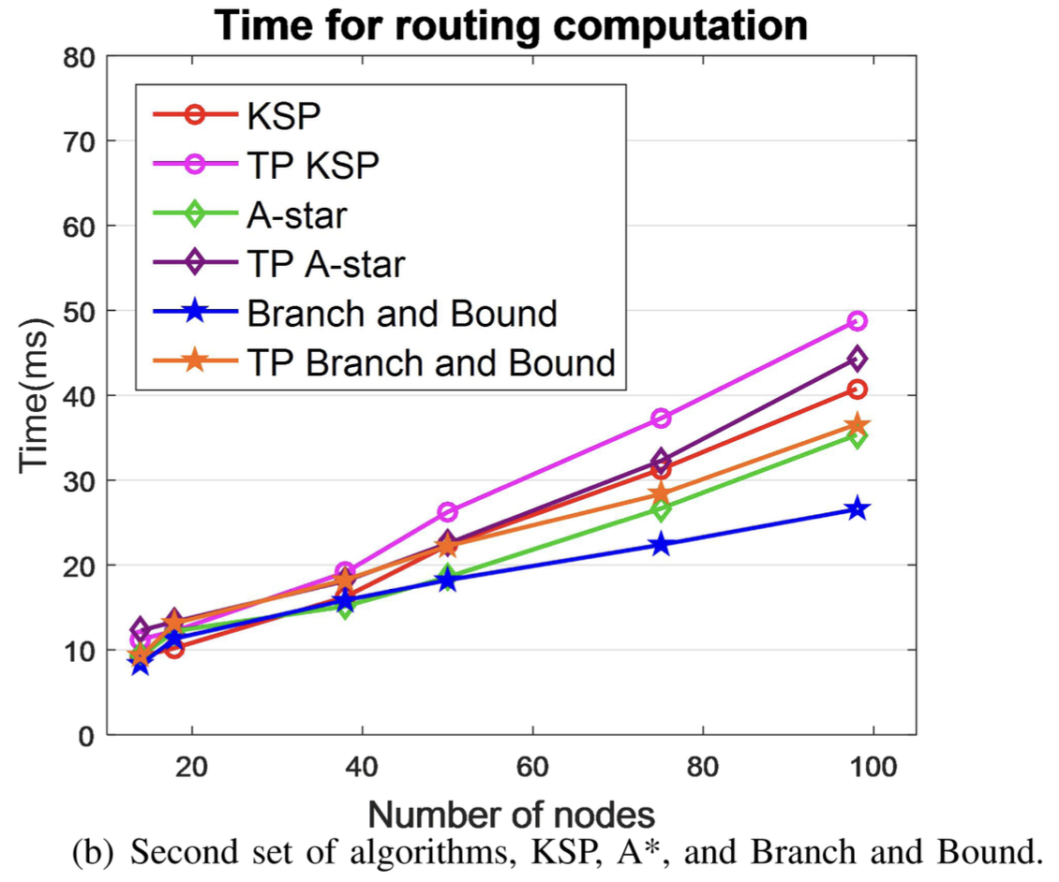
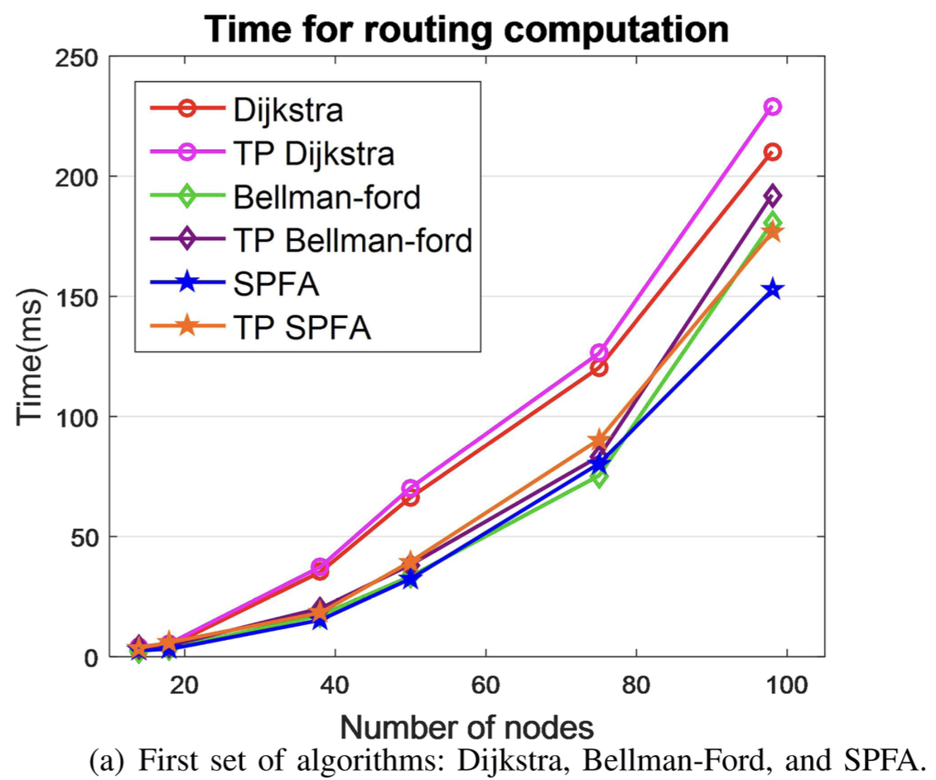
Dynamic Network Topology Portrait for Digital Twin Optical Network
Results:
Construction time for NTP

Slide 12
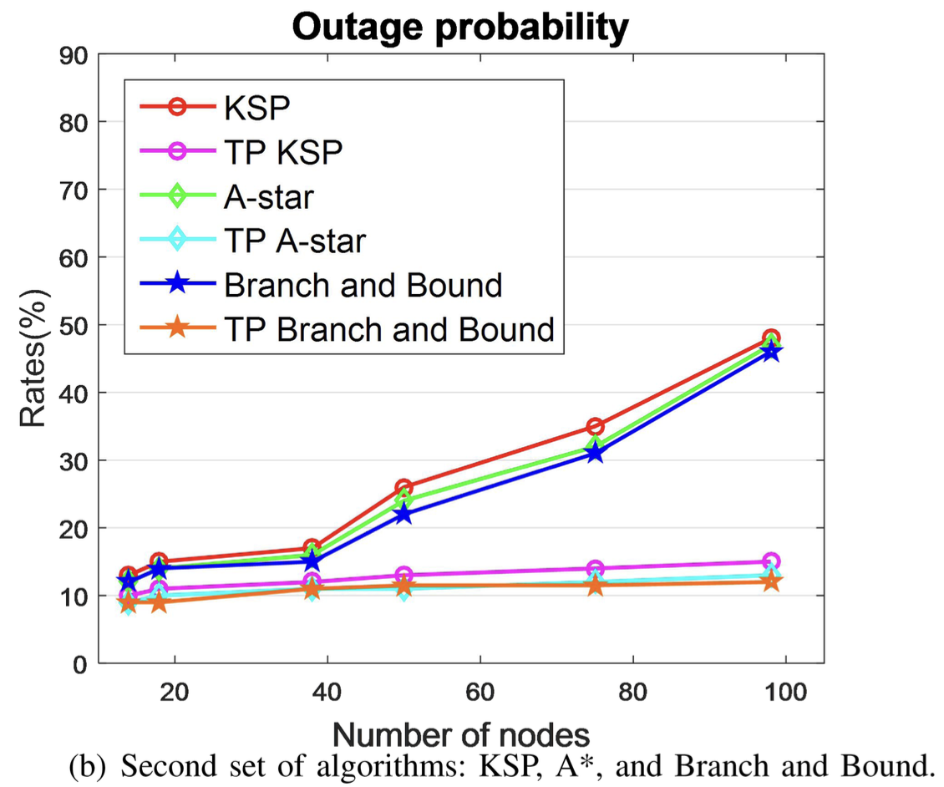
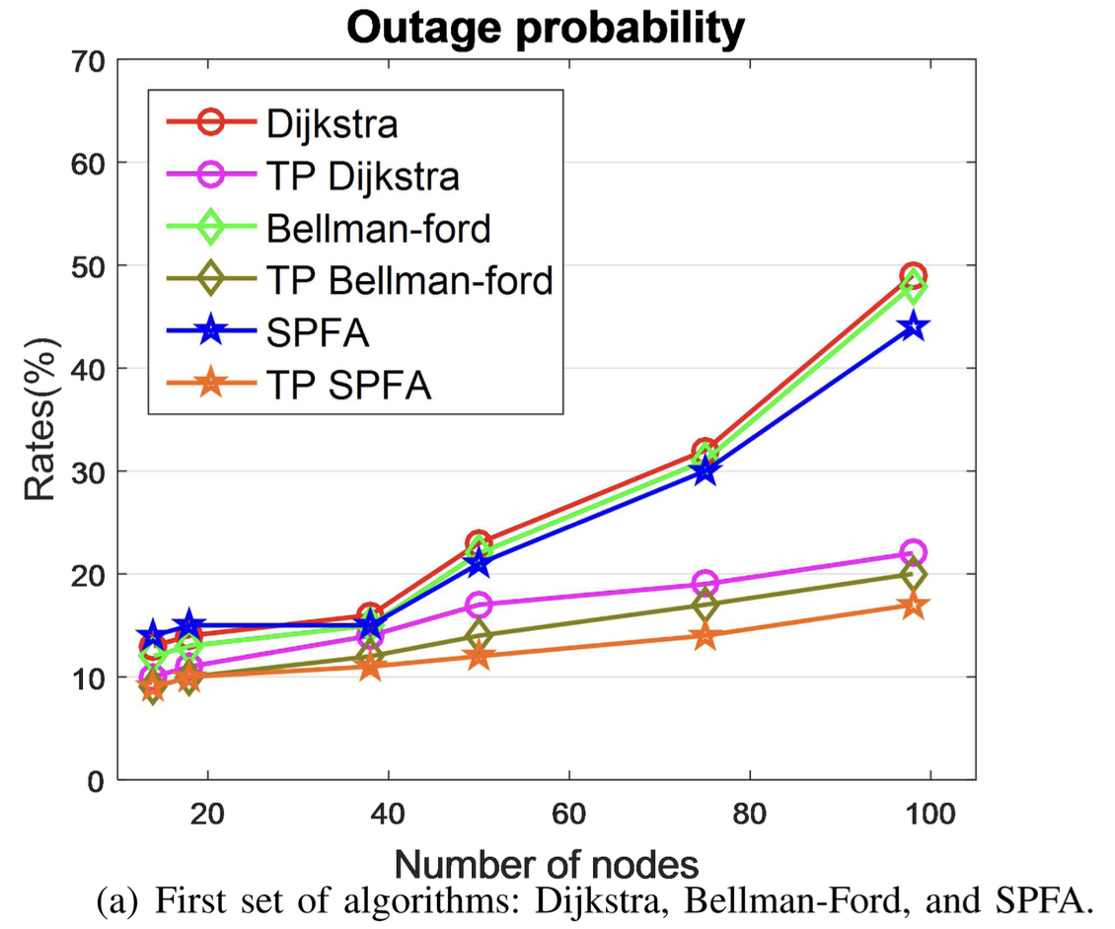
Dynamic Network Topology Portrait for Digital Twin Optical Network
Results:
Outage probability:

Slide 13
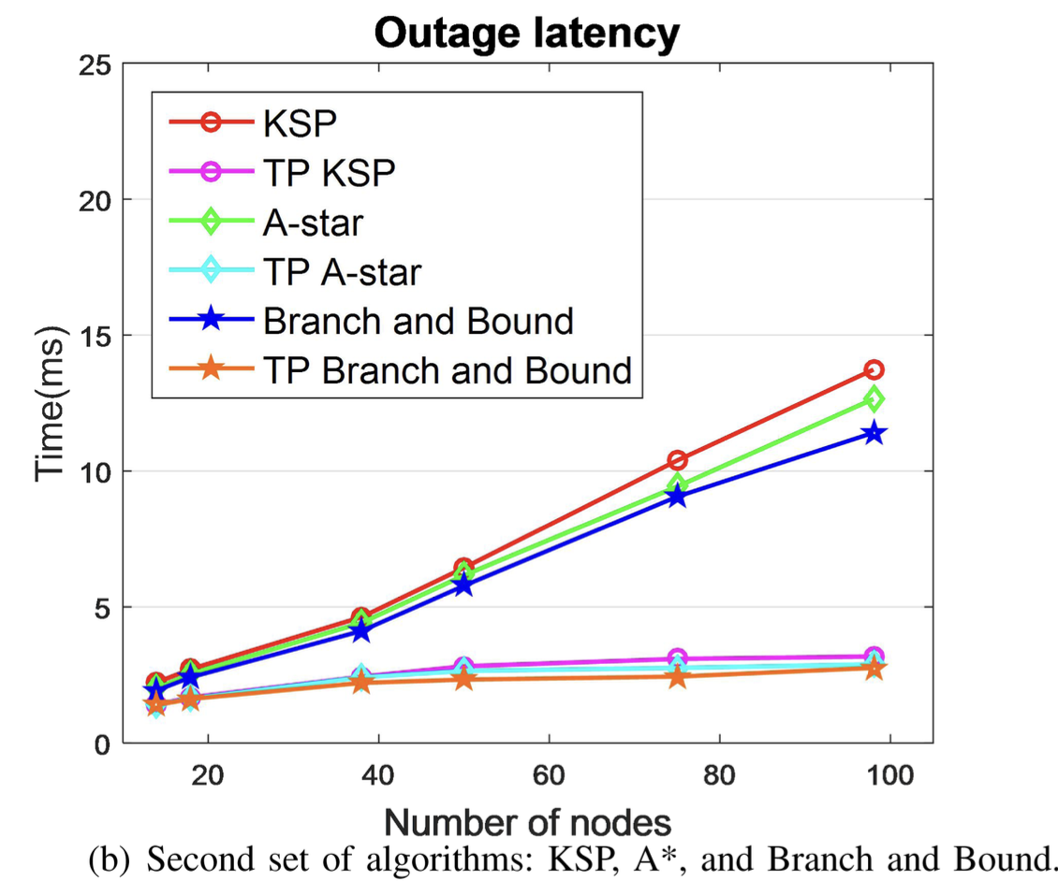
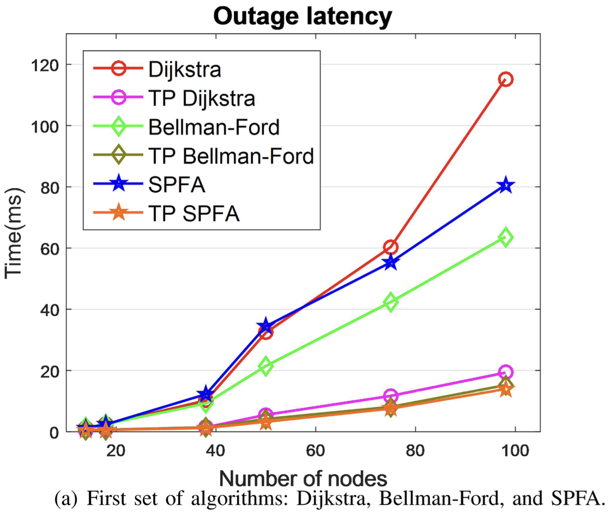
Dynamic Network Topology Portrait for Digital Twin Optical Network
Results:
Outage Latency:

Slide 14
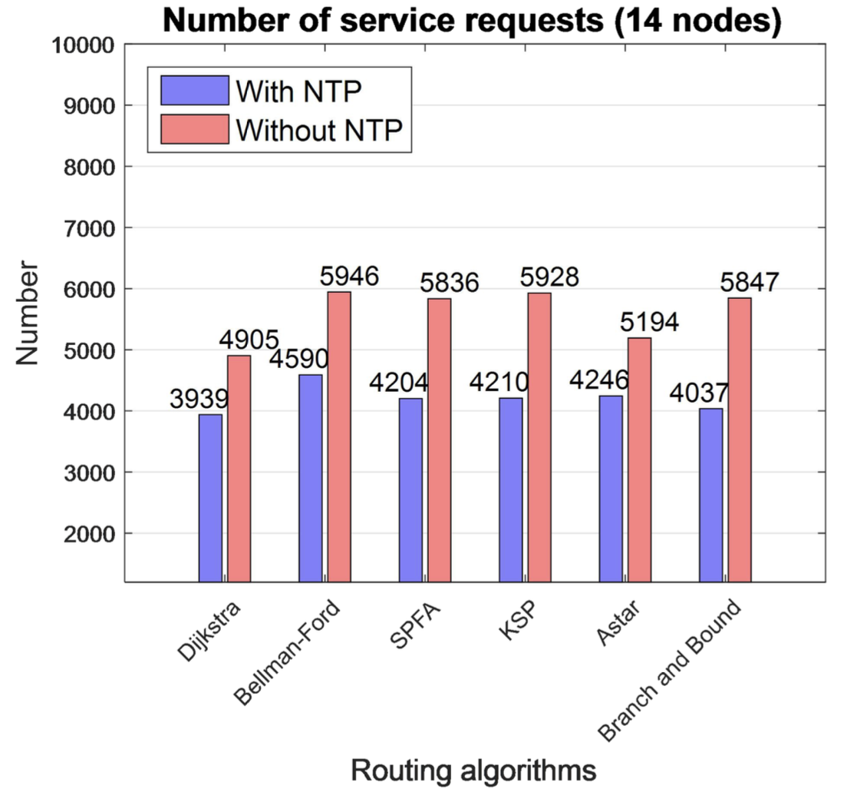
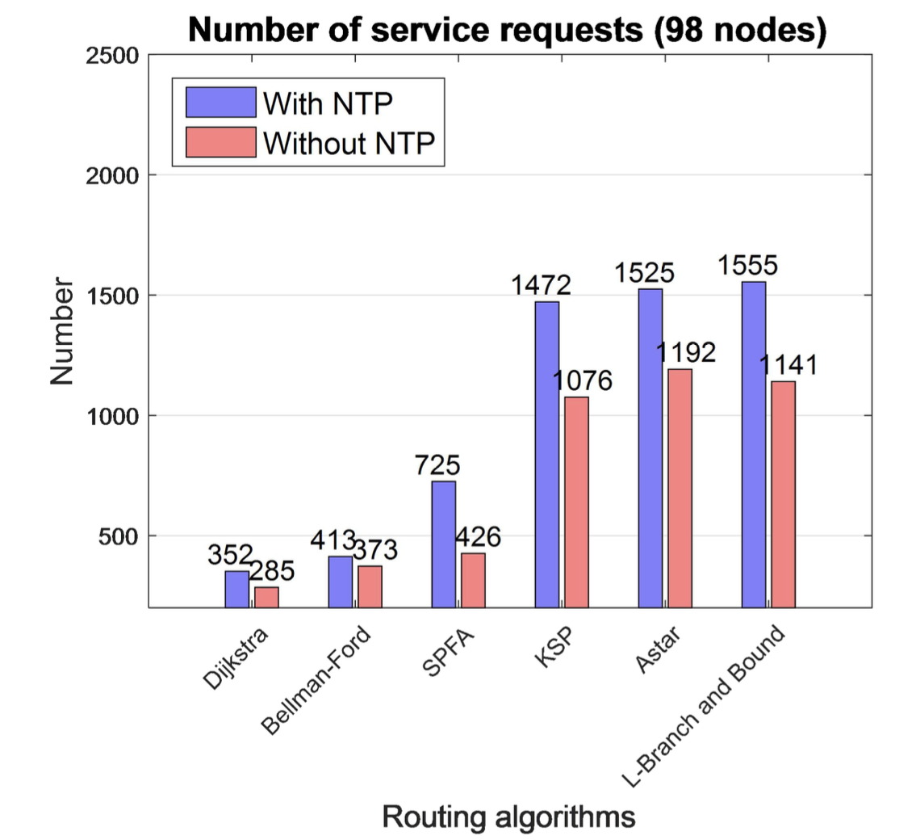
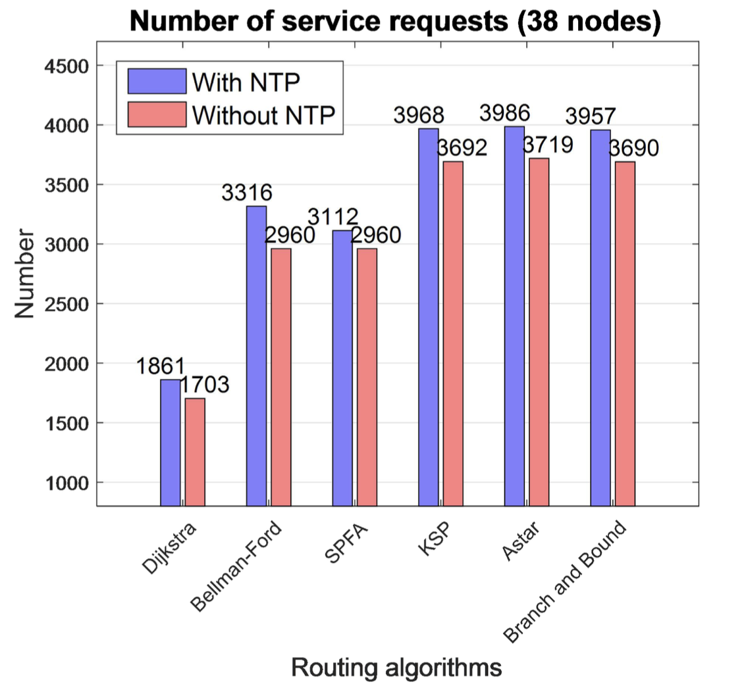
Dynamic Network Topology Portrait for Digital Twin Optical Network
Results:
Number of service requests per minute from the same source node to the destination node for the NTP:

Slide 15
Dynamic Network Topology Portrait for Digital Twin Optical Network
Future study –
DT optical net- work (DTON) was proposed in [3] - D. Wang et al., “The role of digital twin in optical communication: Fault management, hardware configuration, and transmission simula- tion,” IEEE Commun. Mag., vol. 59, no. 1, pp. 133–139, Jan. 2021, doi: 10.1109/MCOM.001.2000727.
quality of transmission (QoT) estimation [6] - A.Ferrari,V.V.Garbhapu,D.L.Gac,I.F.deJaureguiRuiz,G.Charlet, and Y. Pointurie, “Demonstration of AI-Light: An automation framework to optimize the channel powers leveraging a digital twin,” in Proc. Opt. Fiber Commun. Conf. Exhib., 2022, pp. 1–3.

Slide 16
Design and Implementation of a Cloud-Network Resource Management System Based on Digital Twin
Use of Cloud network resource management with DT technology to improve the efficient management ability of the whole life cycle of cloud networks and reduce labor costs.
a demand forecasting model for edge cloud networks is used to guide telecom operators in planning and arranging the resources and services of mobile edge computing (MEC).
In this paper, the overall architecture and key functions of the system are designed, and the capabilities of visual dynamic management, grid management and edge demand forecast are verified by application examples.

Slide 17
Design and Implementation of a Cloud-Network Resource Management System Based on Digital Twin
a DT-based cloud network resource management system is proposed to complete the detailed design of the overall architecture and functions of the system, aiming at realizing the full life cycle, and fine and efficient management of cloud computing and network-related resources.

Slide 18
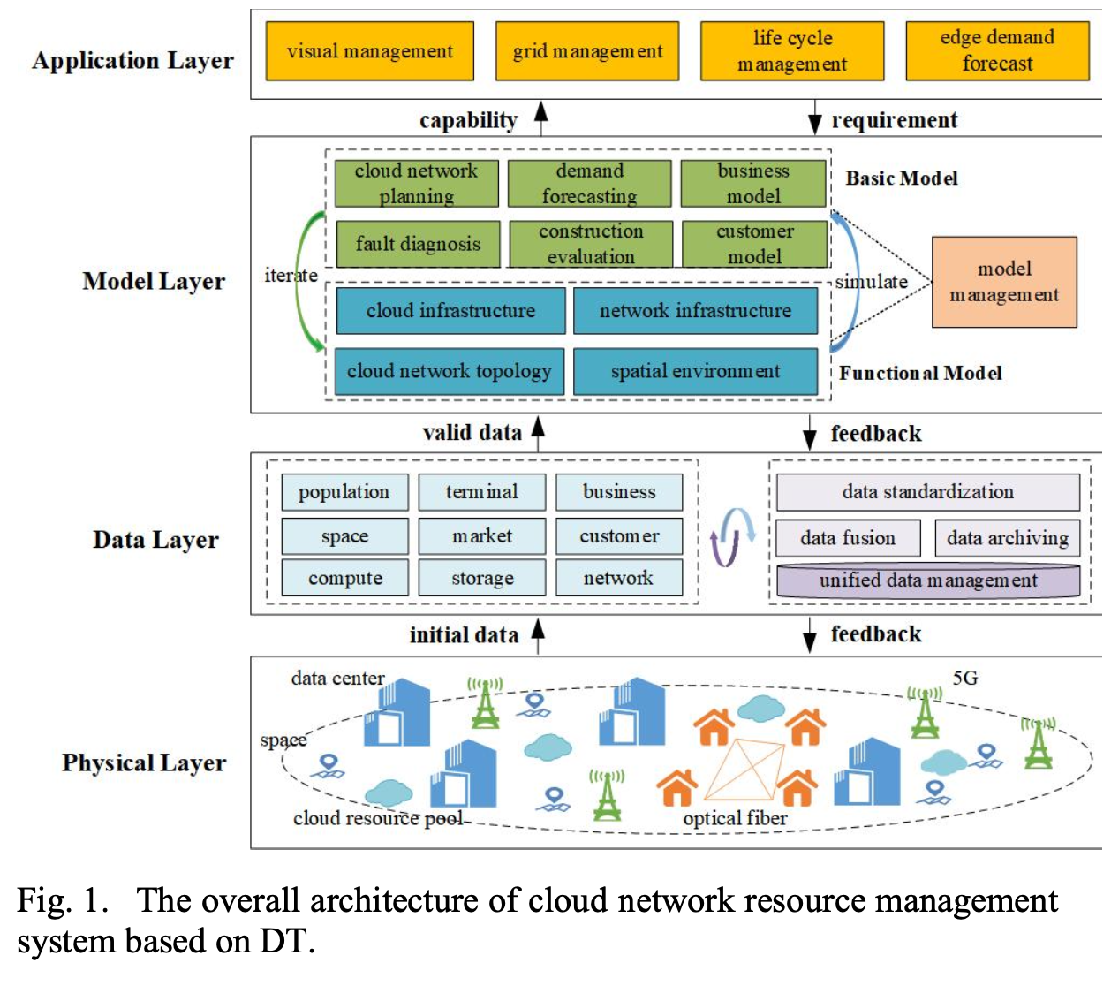
Design and Implementation of a Cloud-Network Resource Management System Based on Digital Twin
System Design –
Overall Architecture of the System - Through the interaction between the physical layer, data layer, and model layer, the digital twins of cloud network resources can be formed
Physical layer: This layer mainly collects the initial data of the physical entities and their external environment through sensors, network probes, and control instructions.
Data Layer: This layer mainly realizes the whole life cycle management of data related to cloud network resource management through data collection, data standardization processing, data fusion processing [8], data application, data archiving, and other operations.

Slide 19
Design and Implementation of a Cloud-Network Resource Management System Based on Digital Twin
System Design –
Overall Architecture of the System –
Model layer - It is mainly responsible for building, verifying, optimizing and managing various models according to the requirements of the application layer. The model of this layer can be divided into two categories: basic model and functional model. The cyclic interaction between them can realize the simulation verification and iterative optimization of the model.

Slide 20
Design and Implementation of a Cloud-Network Resource Management System Based on Digital Twin
System Design –
Model layer –
Basic Model - It mainly includes the cloud infrastructure model, network infrastructure model, cloud network topology model, and spatial environment model, in which the spatial model represents the geographical location and surrounding environment of cloud network resource entities, and their status is monitored.
Functional Model – It mainly includes cloud network planning, demand forecasting, construction evaluation, fault diagnosis, and other models for the application layer to call on demand.
Application Layer - This layer is for system administrators to call the corresponding capabilities of the model layer, data layer, and physical layer according to the actual application requirements, to realize the functions of visual management, grid management, life cycle management, and edge demand forecast of cloud network resources.

Slide 21
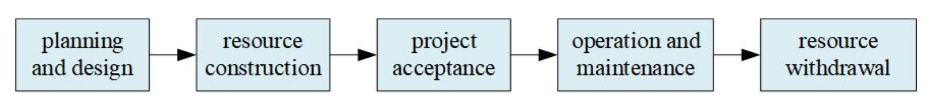
Design and Implementation of a Cloud-Network Resource Management System Based on Digital Twin
System Design –
Life Cycle Management of Cloud Network Resources –
The whole life cycle management process of cloud network resources can be divided into five stages: planning and design, resource construction, project acceptance, operation and maintenance, and resource withdrawal.
Planning and Design - The flexible layout of cloud network infrastructure is achieved online using GIS positioning and topology rule design, following cloud network planning requirements.
Resource Construction - Cloud network resources are constructed based on the planning and design output. By utilizing DT, resources can be initially deployed in virtual space, then optimizing the design scheme through model simulation. Finally, the deployment of resources in physical space is completed according to the optimal design scheme.

Slide 22
Design and Implementation of a Cloud-Network Resource Management System Based on Digital Twin
System Design –
Life Cycle Management of Cloud Network Resources –
Project Acceptance – it involves online data comparison, on-site verification, and other methods. The cloud network resources that have passed the acceptance can be updated from "under construction" to "in operation”. Through DT, this process from demand to planning, construction, and evaluation is closed, improving resource operation stability and reducing labor costs.
Operation and Maintenance - Cloud network resource statuses can be displayed to quickly understand faults and causes. DT enables simulation verification of fault solutions in digital space before distributing the verified solution to physical space, reducing the trial and error cost.
Resource Withdrawal - The system supports historical backtracking for retired cloud network resources, allowing absorption of historical experience and maximizing the use value of these resources.

Slide 23
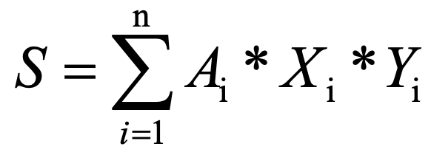
Design and Implementation of a Cloud-Network Resource Management System Based on Digital Twin
System Design –
Edge Demand Forecast of Cloud Network –
Using AI and big data technology, a demand forecasting model for the edge cloud network is constructed based on infrastructure, user, and business data.
This model guides telecom operators in resource layout for the edge cloud network, enabling accurate construction and investment in data-driven resources. It also promotes the coordinated development of edge clouds and edge networks.
By analyzing the business characteristics and infrastructure layout of the edge cloud network, a demand forecasting model for the edge cloud network is proposed.
By using the principles of hierarchical weight calculation and regional normalization, the demand forecast values of edge cloud network resources and services in different regions are calculated.
the hierarchical weight calculation formula:
S is the demand forecast value of the edge cloud network in a certain area.
n is the number of indicators
A_{i} is the parameter value of the key indicator with the serial number i
X_{i} represents the state weight of the i-th key indicator
Y_{i} represents the data category weight of the i-th key indicator, and the data category is related to the indicator types in the first-level indicator and the second-level indicator.

Slide 24
Design and Implementation of a Cloud-Network Resource Management System Based on Digital Twin
System Application Examples –
Visual Dynamic Management of Cloud Network Resources-
The platform enables dynamic management of the physical entities of cloud network resources in digital space. This includes viewing network status information and managing data statistics, enhancing management efficiency and user experience.
Grid Management of Cloud Network Resources in the Whole Life Cycle –
The platform can realize the management and control of network resources according to the integrated service access area, to narrow the scope of resource management and realize refined management.
the platform can also realize the whole life cycle management of network resources, which can be divided into five states: new planning, planning and transformation, construction, transformation, and acceptance, widely called resource grid management.

Slide 25
Design and Implementation of a Cloud-Network Resource Management System Based on Digital Twin
System Application Examples –
Edge Demand Forecast of Cloud Network –
Based on the "grid”, through big data analysis and a demand forecasting model, the platform can realize the calculation of the demand forecast value of the edge cloud network in each grid.
By accurately predicting the demand for edge cloud networks in each area/grid, it can not only guide telecom operators to plan and construct related resources of edge cloud networks in advance but also promote the collaborative innovation of edge cloud and edge network technologies.

Slide 26
Design and Implementation of a Cloud-Network Resource Management System Based on Digital Twin
Future study - "Digital Dual Network-Requirements and Architecture" [5].

Slide 27
OCATA: a deep-learning-based digital twin for the optical time domain
Developing digital twins (Deep-learning-based digital twin for the optical time domain, named OCATA) representing the optical transport network could facilitate various network operation applications, such as automation and fault management.
OCATA utilizes concatenated deep neural network (DNN) models of optical links and nodes to effectively represent lightpaths.
The used DNN-based models aim to extract pertinent lightpath metrics, including length, number of optical links, and nonlinear fiber parameters.
The results of applying OCATA to disaggregated and mixed disaggregated-proprietary optical network scenarios demonstrate remarkable accuracy.

Slide 28
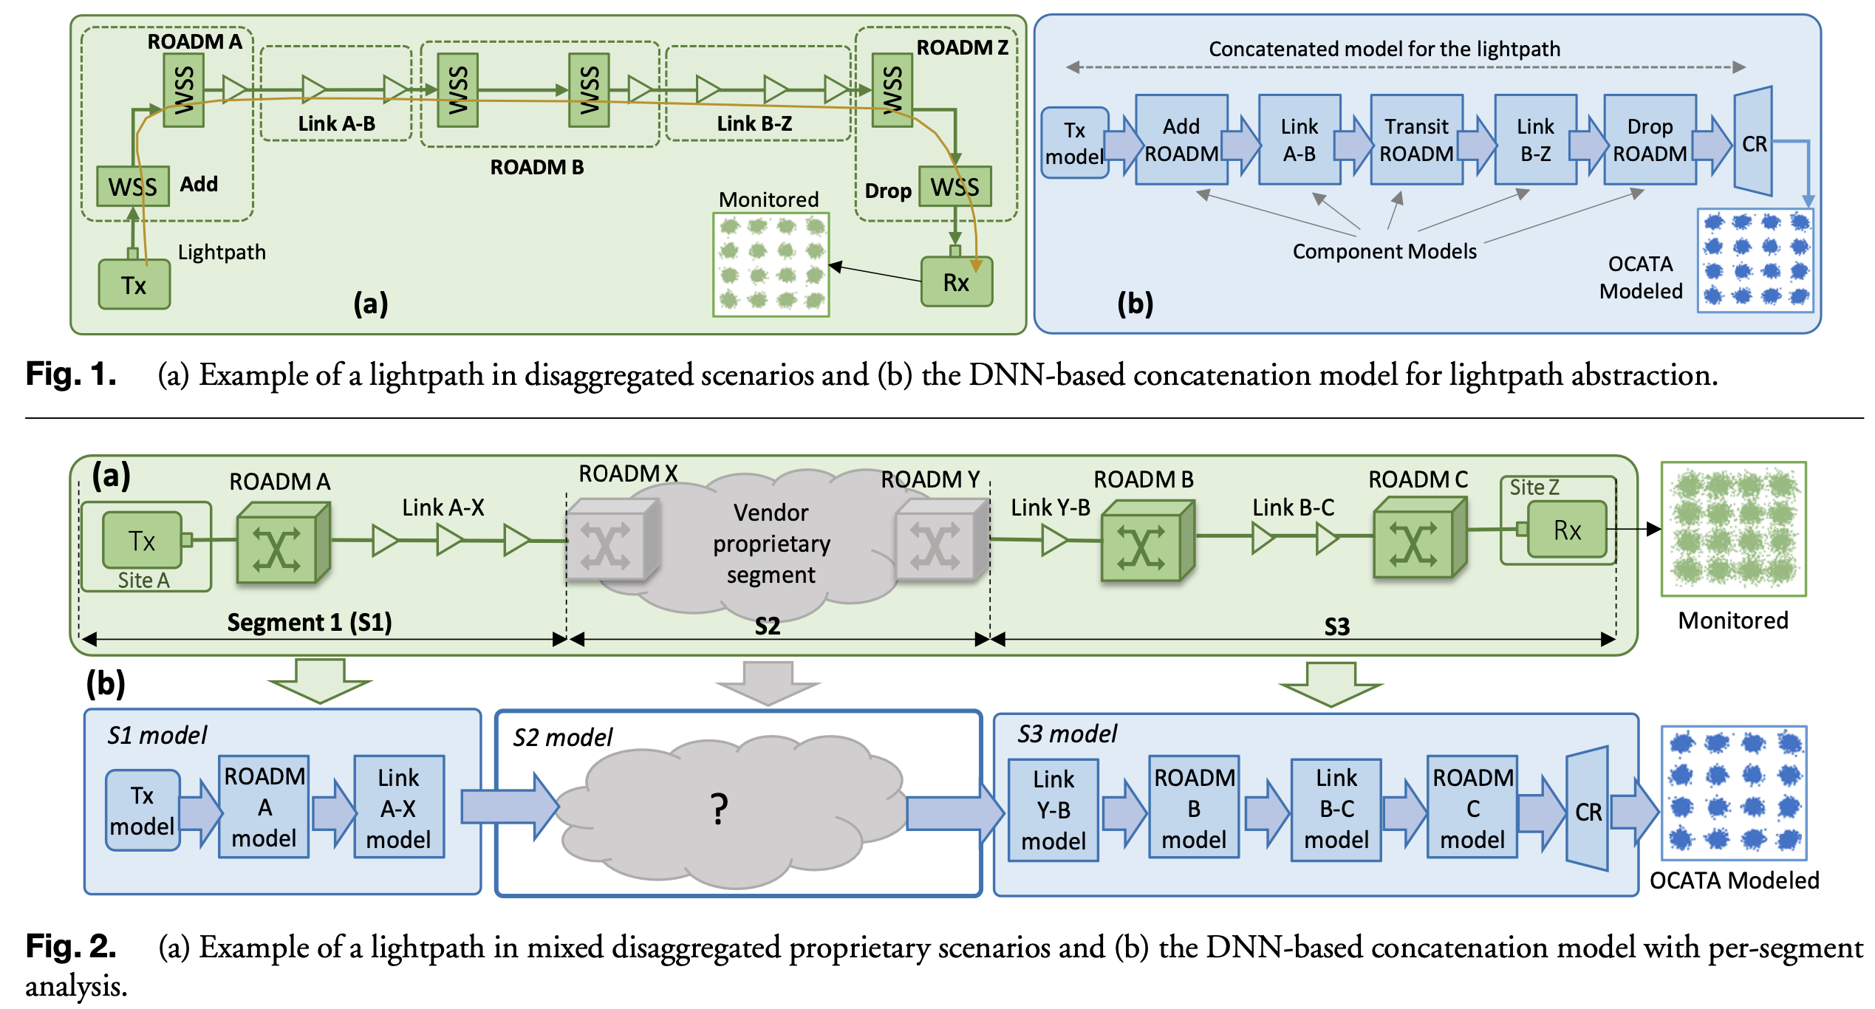
OCATA: a deep-learning-based digital twin for the optical time domain
Optical Time Domain Digital Twin And Application Scenarios -
OCATA investigates two different optical network scenarios:
Disaggregated Optical Networks with transponders, ROADMs, and optical amplifiers from multiple vendors
Mixed Disaggregated Proprietary Networks with single-vendor proprietary islands providing transparent optical connectivity to disaggregated segments.

Slide 29
OCATA: a deep-learning-based digital twin for the optical time domain
OCATA Network Scenarios -
Disaggregated scenario-
Information on network topology, fiber types, and configuration and monitoring data from each optical component is accessible.
For a given lightpath, the models for the various components supporting such a lightpath, including transponders, ROADMs, and optical links are concatenated, where output IQ optical constellation features of one component model are the input features of the following one.
To minimize complexity and ensure component model availability during lightpath provisioning, these models are pre-trained using datasets collected from the network, to reduce complexity even more, only the features of a few selected constellation points are propagated.
A Constellation Reconstruction (CR) module generates constellation point features based on received features to complete the IQ optical constellation.
If the models are accurate, the features of constellation samples from the optical transponder at the endpoint would match the expected optical constellation features from OCATA.

Slide 30
OCATA: a deep-learning-based digital twin for the optical time domain
OCATA Network Scenarios -
Mixed scenario –
vendor-specific optical network management systems (NMSs) provide software interfaces for provisioning but hide details of the underlying optical line systems, such as the lightpath route.
In the proprietary domain, where information about the supporting ROADMs and optical links is unavailable, a concatenation model cannot be constructed as in the disaggregated scenario.
A possible solution is to create an ad hoc DNN model for the whole vendor-proprietary segment and use it to create a concatenated model for the end-to-end lightpath.
the model for the proprietary segment is inferred by analyzing monitored IQ optical constellations and producing similar expected optical constellations.

Slide 31
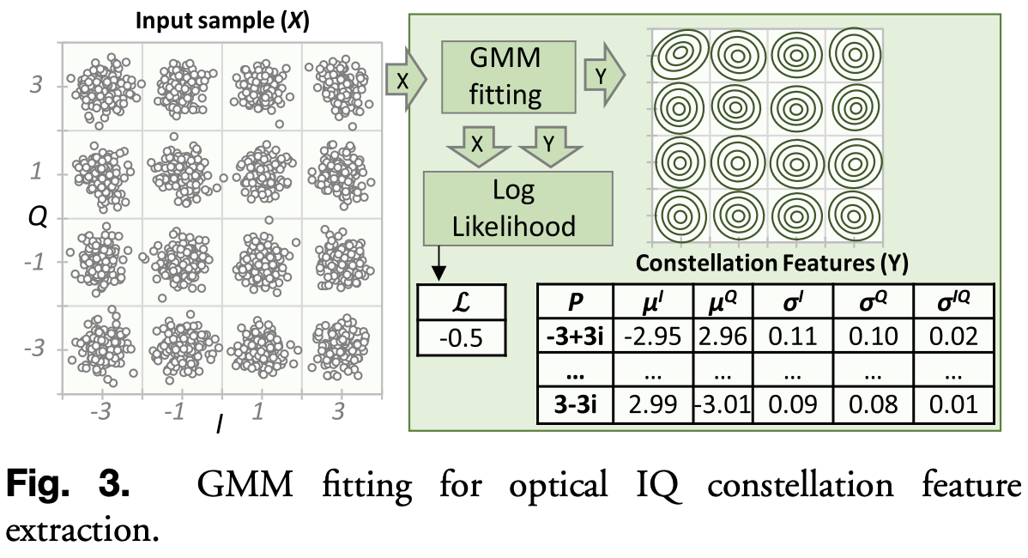
OCATA: a deep-learning-based digital twin for the optical time domain
Deep-learning-based Constellation Modeling –
IQ Optical Constellation Feature Engineering –
A constellation sample is defined by a sequence of complex symbols, where the real and imaginary parts represent the I and Q components of the optical signals.
Gaussian mixture models are applied to the input
sample (16QAM), i.e., one distribution for each
constellation point (16 different distributions).
GMM fitting is done to generate the set of
semisupervised constellation features that
summarizes the sample with several clear,
unique, and predefined statistical characteristics.
Each constellation point is characterized by five
features (2 for the mean position in the constellation
and 3 for the real and imaginary variance and
symmetric covariance terms that the symbols)

Slide 32
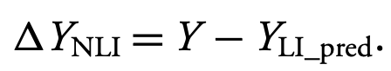
OCATA: a deep-learning-based digital twin for the optical time domain
Deep-learning-based Constellation Modeling –
Linear Links and ROADMs Models –
The DNN-based models target to propagate the LI features. The DNN-based models are developed to obtain after GMM fitting considering the LI noise only.
The propagation of features under LI noise introduces nonlinear changes in the features.
The constellation points that are propagated are limited to a selected subset (4 for 16QAM, thus, each DNN for 16QAM signals receives four constellation points × 5 features = 20 inputs).
Three DNN models: add ROADM A, link A-B, and drop ROADM B.
Nonlinear Residuals Models –
the features are predicted related to the LI noise but without nonlinear impairments.
NLI residual features are given by:

Slide 33
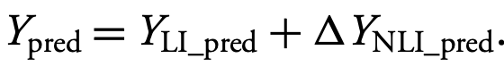
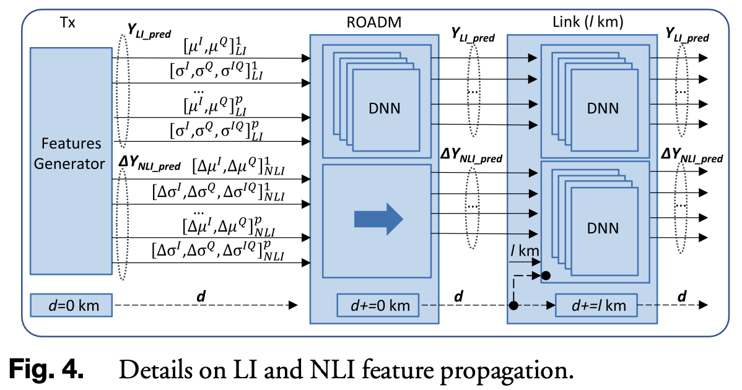
OCATA: a deep-learning-based digital twin for the optical time domain
Deep-learning-based Constellation Modeling –
The obtained NLI residuals and linear features; the predicted features for the signal are given as:
Constellation Reconstruction –
CR is the process that predicts the features of every constellation point as a function of the features of the propagated ones.

Slide 34
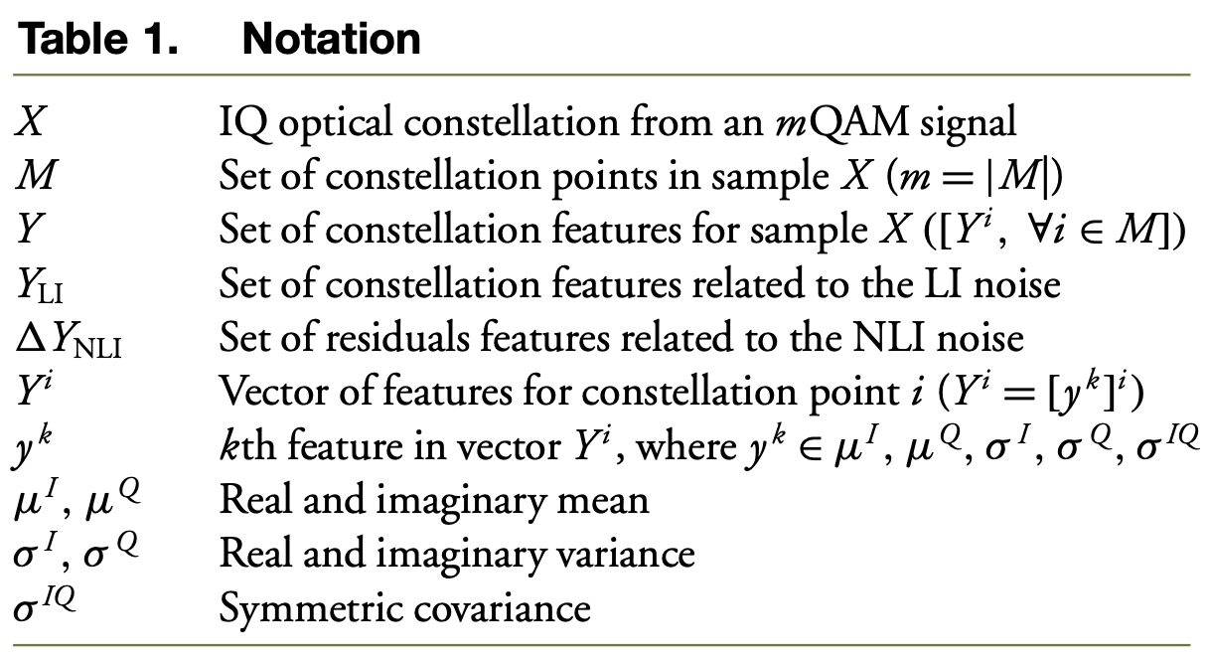
OCATA: a deep-learning-based digital twin for the optical time domain
Notations used in the algorithm -

Slide 35
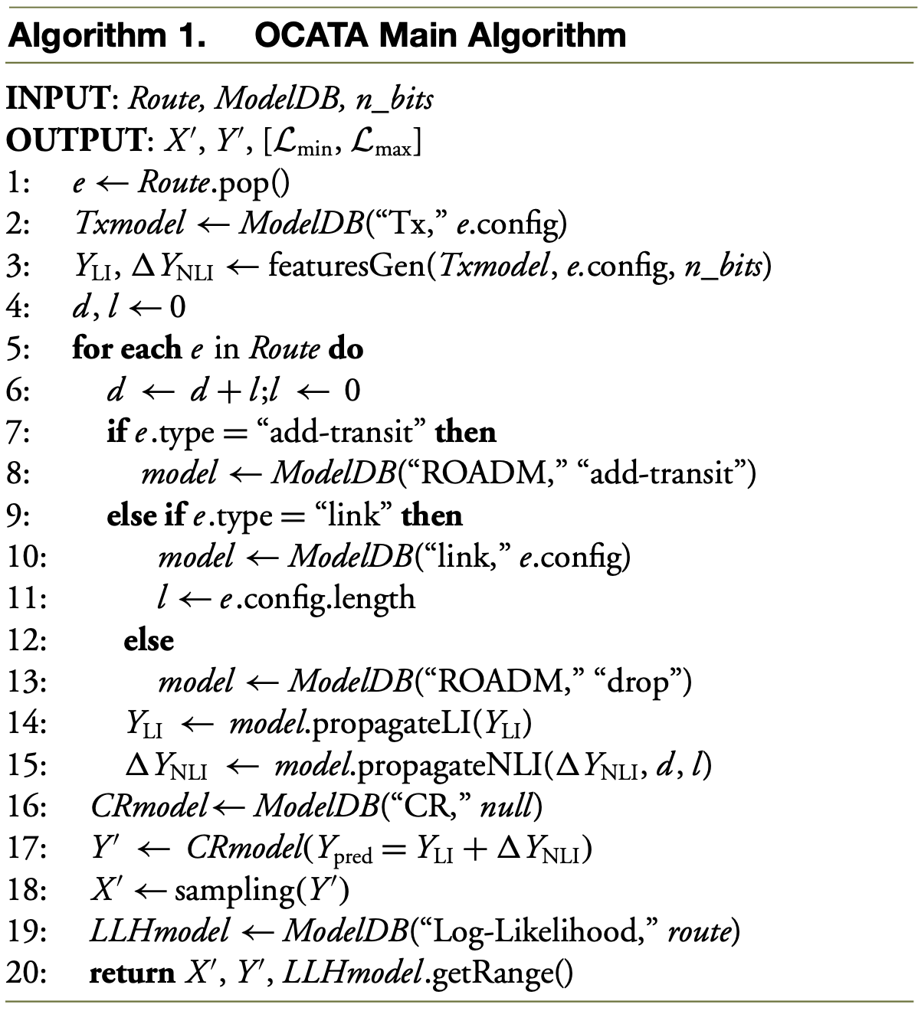
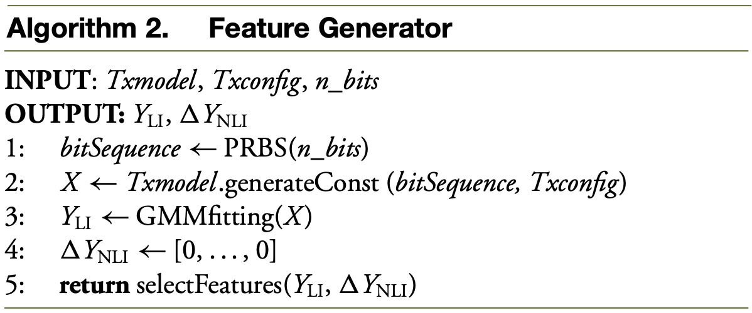
OCATA: a deep-learning-based digital twin for the optical time domain
Digital Twin For The Optical Time Domain And Constellation Analysis –
OCATA for Disaggregated Optical Networks –

Slide 36
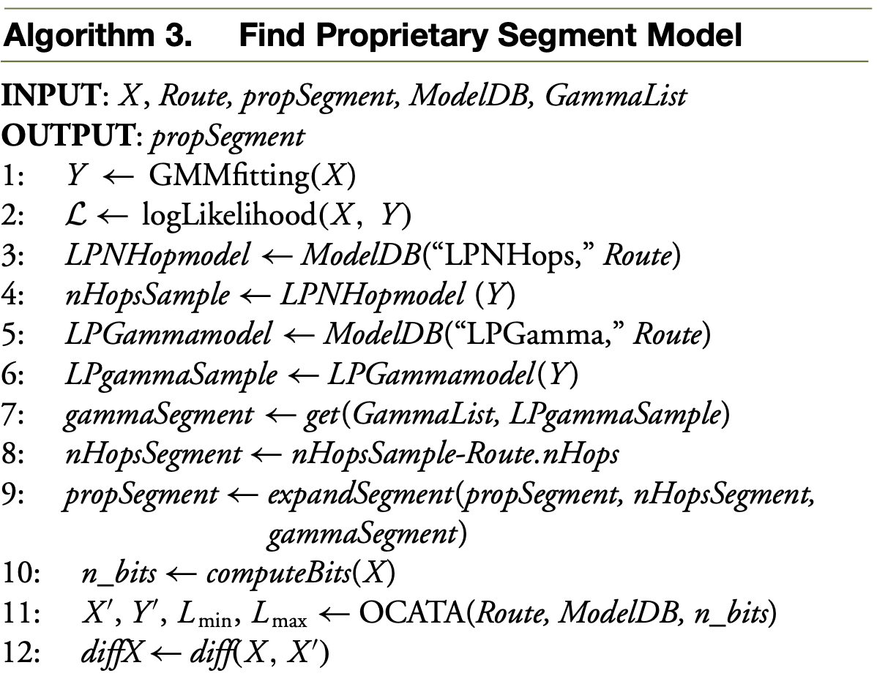
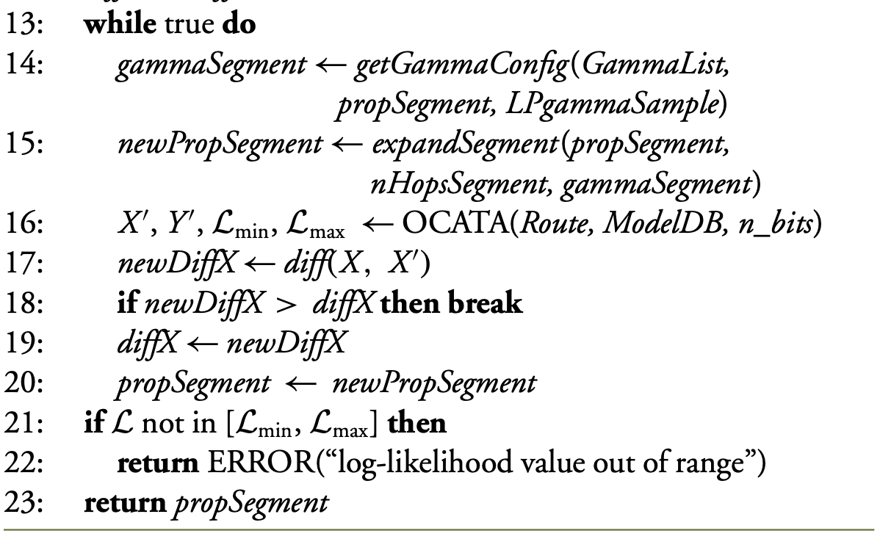
OCATA: a deep-learning-based digital twin for the optical time domain
Digital Twin For The Optical Time Domain And Constellation Analysis –
Tuning OCATA with Received Samples–
A methodology that allows us to identify an unknown network configuration by tuning OCATA to force the generated IQ optical constellations to be as close as possible to the received ones.
This methodology is applied in mixed disaggregated proprietary optical networks, where the configuration of the proprietary segment is not completely known.

Slide 37
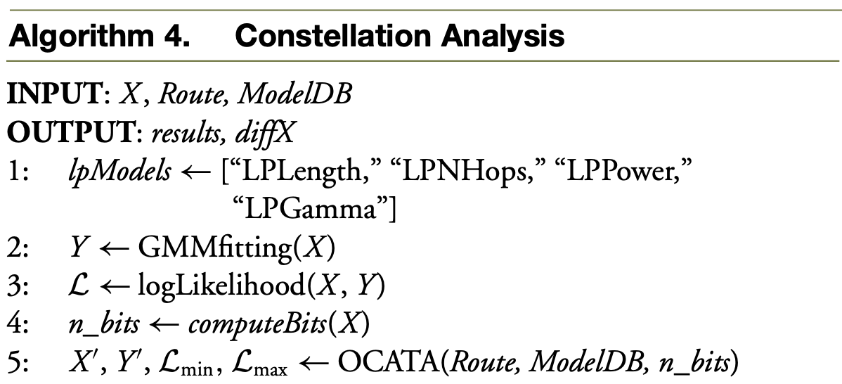
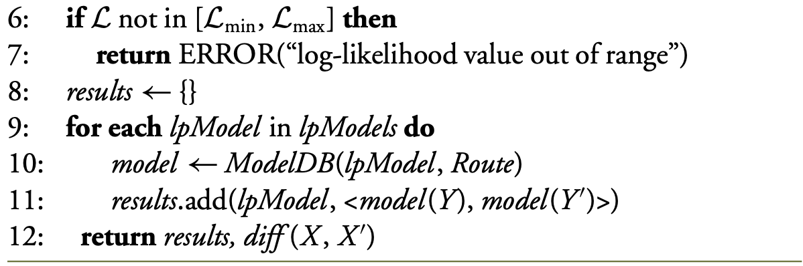
OCATA: a deep-learning-based digital twin for the optical time domain
Digital Twin For The Optical Time Domain And Constellation Analysis –
Constellation Analysis –
Compares the lightpath’s metrics predicted from the features of received and generated optical constellations and returns the results of the comparison.

Slide 38
OCATA: a deep-learning-based digital twin for the optical time domain
Results –
Optical Signal Sample Generation:
16QAM at 64 GBd with a 75 GHz channel spacing
The fiber was modeled as standard single-mode fiber characterized by an attenuation factor of 0.21 dB/km
optical links - 100 km (2 spans of 50 km), 200 km (4×50km), 240 km (4×60km), 300 km (4×75km), 400 km (5×80km), 500 km (5×100km), and 560 km (7×80km)
Two to five cascaded ROADMs (from one to four hops), optical signal samples for lightpaths with total length ranging from 100 to 2240 km.
For every scenario, 10 signal samples were generated using 2¹³ PRBSs and shaped by a root-raised cosine filter with a roll-off factor of 0.06.
The whole dataset contains 3520 signal samples.

Slide 39
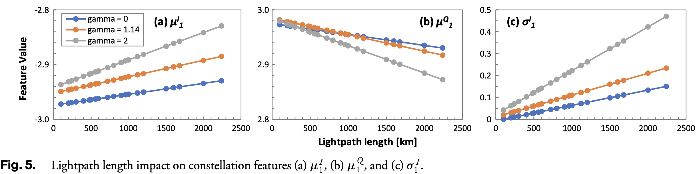
OCATA: a deep-learning-based digital twin for the optical time domain
Results –
Constellation Features and Log-Likelihood Analysis
optical constellation features as a function of the total lightpath length for constellation point 1 (−3 + 3i )

Slide 40
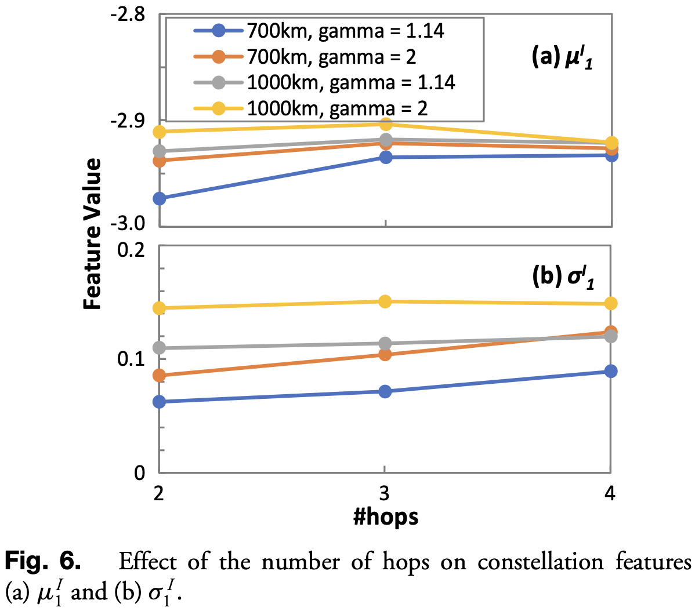
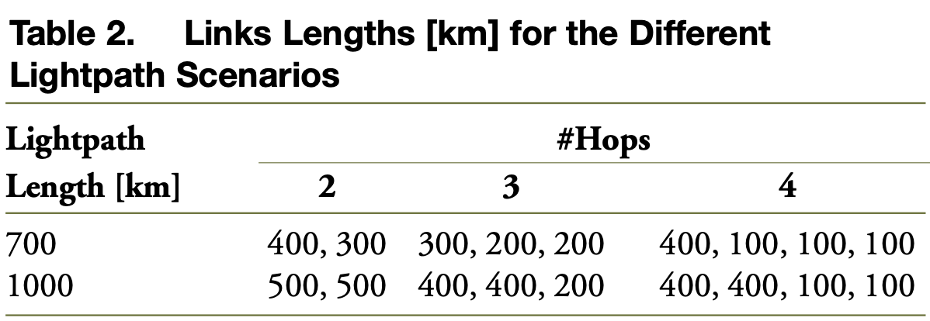
OCATA: a deep-learning-based digital twin for the optical time domain
Results –
Constellation Features and Log-Likelihood Analysis
evolution of the features as a function of the number of hops for four lightpath scenarios

Slide 41
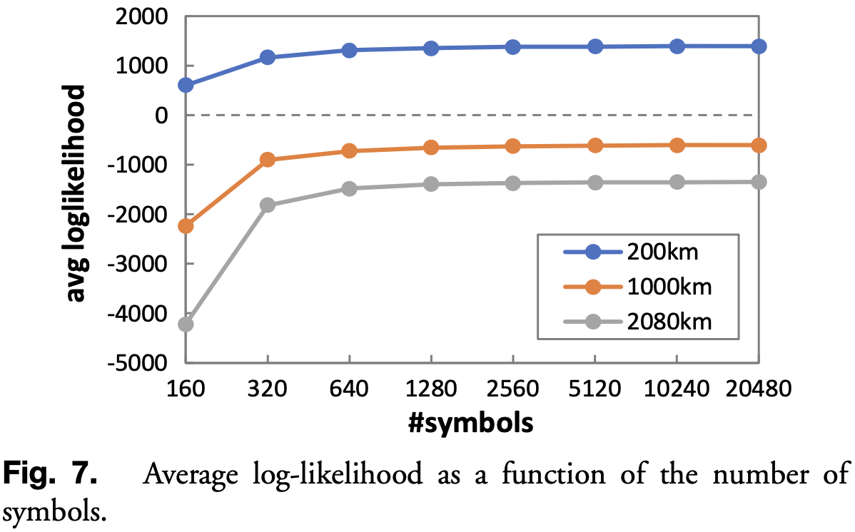
OCATA: a deep-learning-based digital twin for the optical time domain
Results –
Constellation Features and Log-Likelihood Analysis
the log-likelihood of the bivariate Gaussian distribution that characterizes a given optical signal sample

Slide 42
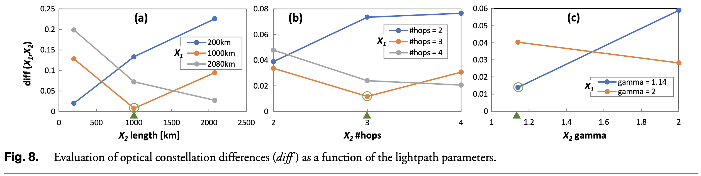
OCATA: a deep-learning-based digital twin for the optical time domain
Results –
Constellation Features and Log-Likelihood Analysis
the performance of the constellation comparison function (diff) as a function of several lightpath parameters, including total length, number of hops, and coefficient γ
Observation - the minimum diff value is achieved when X1 and X2 are from lightpaths with the same configuration.

Slide 43
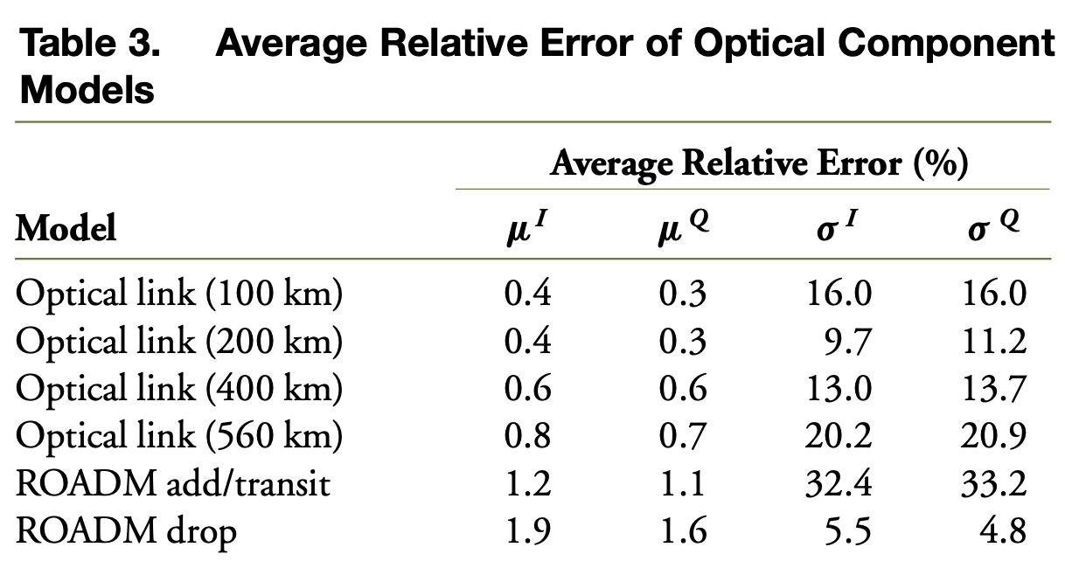
OCATA: a deep-learning-based digital twin for the optical time domain
Results –
OCATA Performance Evaluation –
Selected constellation points - two inner and two outer ones: 1 (−3+3i), 7(1+1i), 10(−1−1i), 15(1−3i)
disaggregated network scenario -

Slide 44
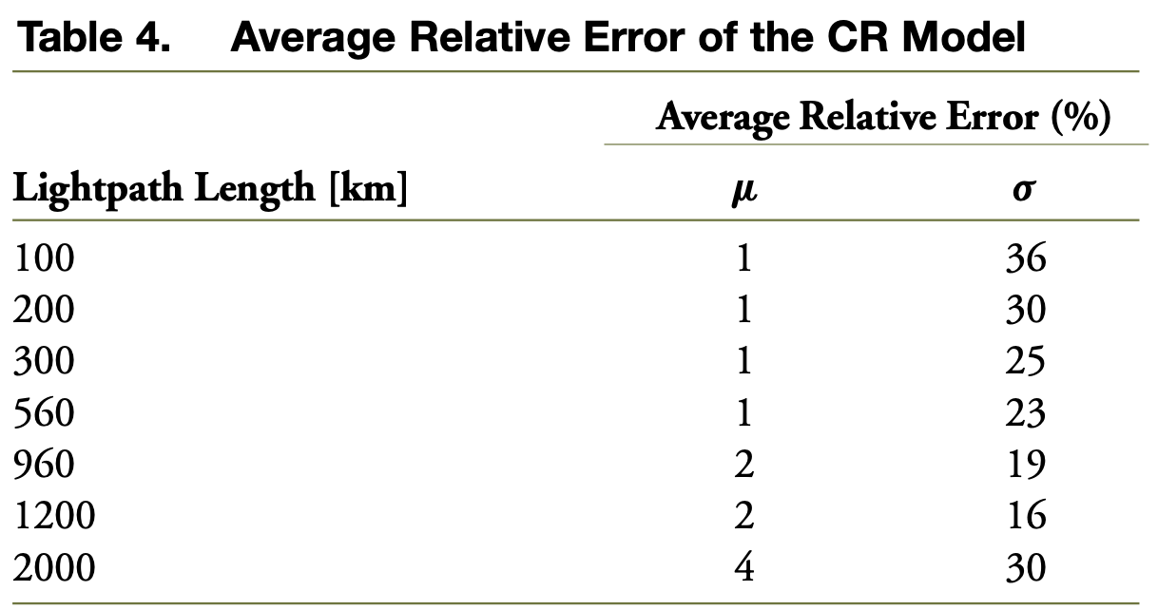
OCATA: a deep-learning-based digital twin for the optical time domain
Results –
OCATA Performance Evaluation –
the reconstruction of the nonpropagated constellation points that is carried out using the CR model

Slide 45
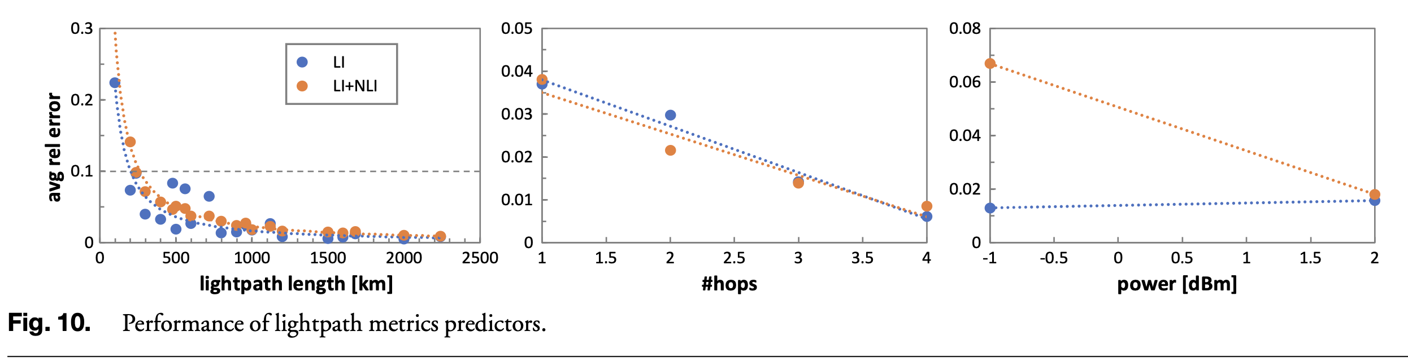
OCATA: a deep-learning-based digital twin for the optical time domain
Results –
OCATA Performance Evaluation –
mixed disaggregated proprietary optical network scenario -

Slide 46
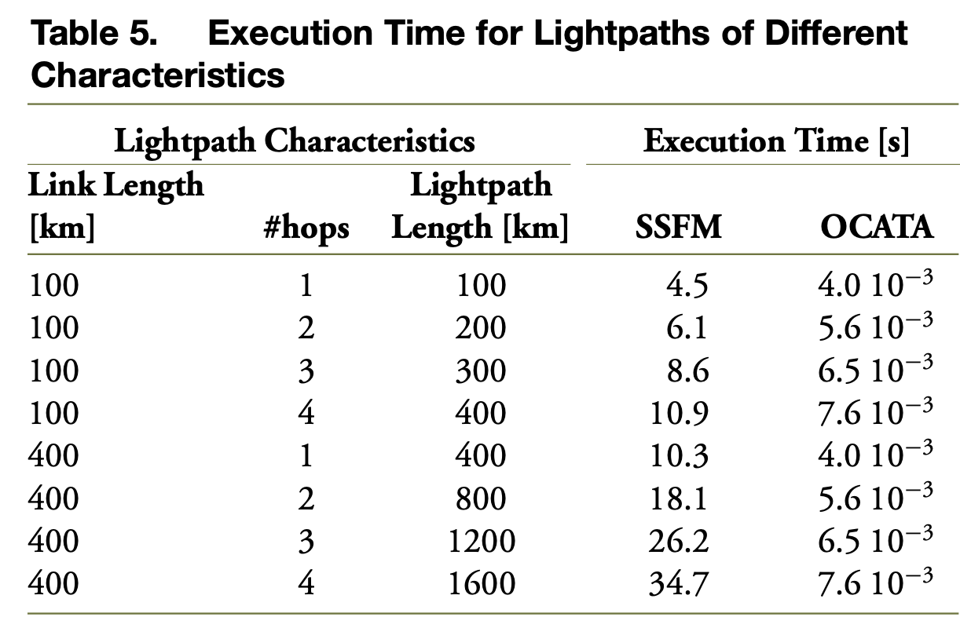
OCATA: a deep-learning-based digital twin for the optical time domain
Results –
OCATA Performance Evaluation –
the computation time of OCATA and compare it with SSFM

